Slide 1

Primary Key
Infoway Technologies, 3rd Floor Commerce Centre, Rambaug Colony, Paud Road Pune 411038

Slide 2
Primary Key
A primary key is one of the most important steps in good database design. A primary key is a special column (or set of combined columns) in a relational database table, that is used to uniquely identify each record. Each database table needs a primary key.
Infoway Technologies, 3rd Floor Commerce Centre, Rambaug Colony, Paud Road Pune 411038

Slide 3
Rules of Primary Key
student table
firstName | lastName | DoB | city | …
rajesh | kumar | 1999-03-20 | pune | …
sunil | kumar | 2000-12-24 | baroda | …
rajesh | kumar | 1999-03-20 | pune | …
ID | firstName | lastName | DoB | city | …
1 | rajesh | kumar | 1999-03-20 | pune | …
2 | sunil | kumar | 2000-12-24 | baroda | …
3 | rajesh | kumar | 1999-03-20 | pune | …
PRIMARY key must follow some rules.
A primary key cannot be NULL.
A primary key value must be unique.
A table has only one primary key.
Infoway Technologies, 3rd Floor Commerce Centre, Rambaug Colony, Paud Road Pune 411038

Slide 4
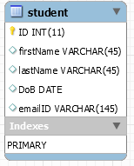
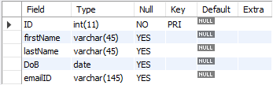
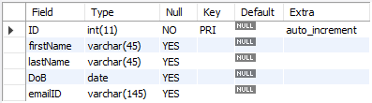
Example of Primary Key
Examples of Primary Key
CREATE TABLE student (
ID INT(11) PRIMARY KEY,
firstName VARCHAR(45),
lastName VARCHAR(45),
DoB DATE,
emailID VARCHAR(145)
);
CREATE TABLE student (
ID INT(11) PRIMARY KEY AUTO_INCREMENT,
firstName VARCHAR(45),
lastName VARCHAR(45),
DoB DATE,
emailID VARCHAR(145)
);
Infoway Technologies, 3rd Floor Commerce Centre, Rambaug Colony, Paud Road Pune 411038

Slide 5
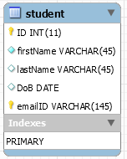
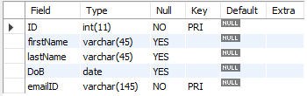
Composit key
Composite key, or composite primary key, refers to cases where more than one column is used to specify the primary key of a table. In such cases, all foreign keys will also need to include all the columns in the composite key.
Note that the columns that make up a composite key can be of different data types.
Examples of composit Primary Key
CREATE TABLE student (
ID INT(11),
firstName VARCHAR(45),
lastName VARCHAR(45),
DoB DATE,
emailID VARCHAR(145),
PRIMARY KEY (ID, emailID)
);
Infoway Technologies, 3rd Floor Commerce Centre, Rambaug Colony, Paud Road Pune 411038

